Slide 1


Slide 2
Final Project
Online Admission System
(OAS)

Slide 3
Introduction
Submitted By :
Muhammad Azhar Mehmood
Roll No:
MCE-IT-11-06.
Supervised By:
Engr. Muhammad Adnan Alvi.

Slide 4
Introduction Of OAS
The student admission is one of the most important activities within a college as one cannot survive without students. A poor admissions system can mean fewer students being admitted into a college because of mistakes or an overly slow response time. The first step for students is to apply directly to the college through a custom online form. The next step is for the Admissions service center has to review the application and ensure that all of the required information has been provided, from the form itself.

Slide 5
Project goals and objectives
Goals:
Elimination of paper work.
Online submission of application form.
Avoid duplications.
Creating electronic merit lists.
Reduce the time and save the money of student.
Correctness.
Maintainability.
Manage all details of student who registered for the course and maintain the appropriate Details about the course to the students account.

Slide 6
Project goals and objectives
Objectives:
The mechanism of online admission requires to be performed in less consumption of time. So the intensions of College are to improve the admission system.
Computerization of the system is a best way to improve the functionality as a whole.
Increasing the efficiency, saving time and removing human errors during recording students/faculty data.
Providing accurate information for any candidate that has applied for management system when required. Main Objectives are
Reduce the cost.
Reduce the time.
Reduces Paper Work.

Slide 7
OAS Scope
Scope of the system
Providing security .
Details maintenance about college.
Creating electronic merit lists
Create student accounts and maintain the data effectively.
View all the details of the students
Activities like updating, modification, deletion of records are lot easier.

Slide 8
Description & Drawbacks of existing system
Description of existing system :-
The system at present working manually, that means all the working done within the system is maintained in the paper, thus the management needs the computerized system. The Current System cannot meet the present and future challenges. There is probability of occurring a duplicate record in register because the data is dispersed on multiple register.

Slide 9
Description & Drawbacks of existing system
Drawbacks of existing system:-
Process of searching is tough and very time consuming.
Data redundancy problem in case any register lost.
The process is very time consuming..
Chances of form misplacement are very high, because of huge number of applications. Difficulty in maintenance of records.
To manage the register record is complicated.
Mistake occurring in long calculations.
Data inconsistency.

Slide 10
Description of proposed system
Reduced manual work by using computerized system.
Proposed system is user friendly so it is easy to operate.
The Computerized system Saves time.
Ensure data security.
Share the student and staff information effectively
System is helpful to see the present status of Admission.
Fast and accurate merit list generation

Slide 11
Tool Selection
Selection of the appropriate software is most crucial stage of the development phase. The choice of software tool should be done in keeping view of the problem faced in order to avoid heavy loss of time and money. Tools used for any system development are:
1. Hardware
2. Software

Slide 12
Tool Selection
Software:-
Any hardware without software is seemed to be useless in this environment. So different types of software are considered for this specific purpose. Chosen ones are:
Operating System Windows 7/Windows 8
Front end tool HTML, CSS
Back end tool PHP , Java script
Graphic Designing tool Dreamweaver CS6
Database MS SQL
Tools for documentation MS Word

Slide 13
Tool Selection
Hardware:-
For the development and designing of website we had used better hardware for better functioning of the operating system and faster loading of programs. Hardware required to run this system will be:
Machine Intel CORE i5
Processor Intel(R) Core(TM) i5-2520M CPU @ 2.50GHz
RAM 6 GB
Intel HD Graphics 3000.

Slide 14
Tools Used for development
Tools and Using Reasons :-
PHP
For making interface and coding.
My SQL
To keep the record of users and their details also for maintaining User personal data for booking request.
MS Word
For ERD diagram, For Use Case diagram ,System Sequence diagram, Sequence diagram.

Slide 15
Tools Used for development
Tools and Using Reasons :-
CSS
For Style.
Java Script
For handle events and form validation.
Dreamweaver CS6
For making interfaces /front –end and admin panel.
HTML
For front end page management.

Slide 16
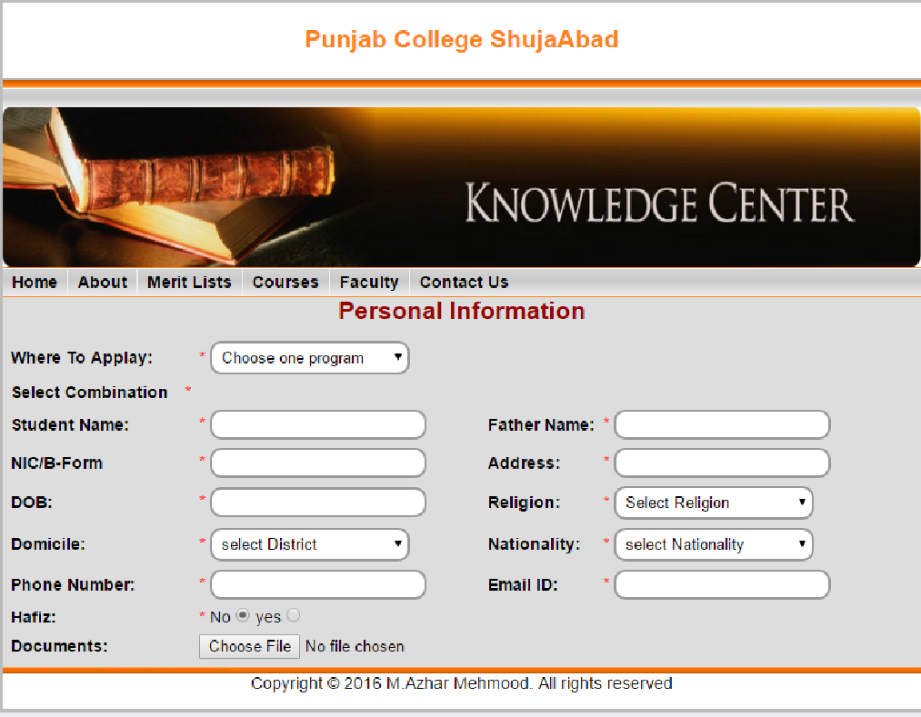
Admin Panel Interface

Slide 17
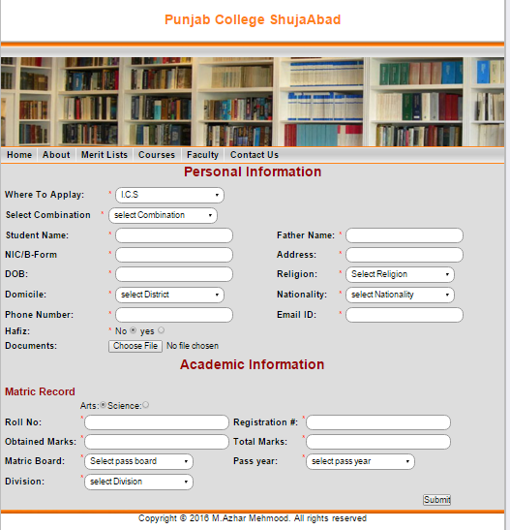
User Interface

Slide 18
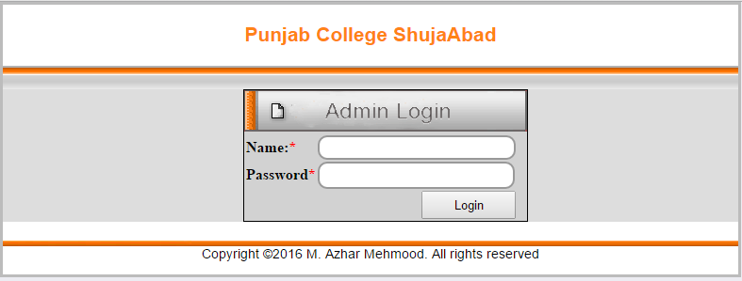
Admin Panel Interface

Slide 19
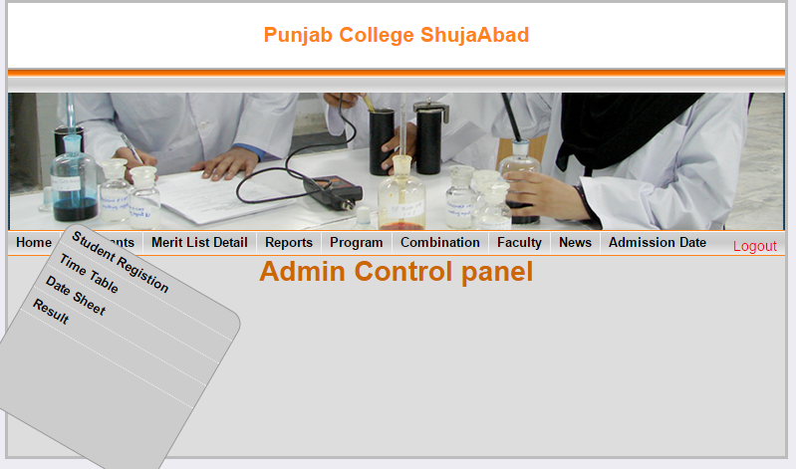
Admin Control Panel

Slide 20
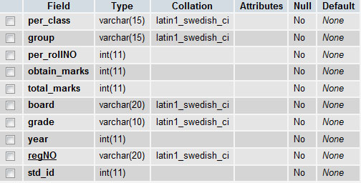
Academic Data Base

Slide 21

Admin Panel

Slide 22

Admission Detail

Slide 23
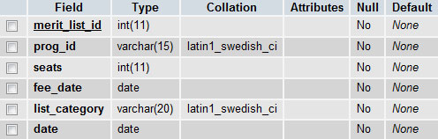
Merit List

Slide 24


